Slide 1
SHORT-RESPONSE ESSAYS
by VICTOR TEDDY

Slide 2
THE ESSENCE OF SHORT-RESPONSE ESSAYS
They’re ideally meant to give you room to share interesting aspects about yourself that you didn’t get a chance to share elsewhere in the application.
It’s a chance for you to be spontaneous and show that you’re a multifaceted person – humanize your application!
A gateway to your personality through the mundane things that you’re into – be strategic and intentional with your responses.
They may be short, but hold equal weight as other parts in your application. TAKE YOUR TIME WITH THEM!

Slide 3
SAMPLE ESSAYS (35-50 WORDS OR FEWER)
What inspires you?
You are teaching a new yale course. What's it called?
Yale’s residential colleges regularly host conversations with guests representing a wide range of experiences and accomplishments. What person, past or present, would you invite to speak and what would you ask them to discuss?
What is something about you that is not included anywhere else in your application?
What is a new skill you would like to learn in college?
What brings you joy?
What song represents the soundtrack of your life at this moment?
What is the most significant challenge that society faces today?
What historical moment or event do you wish you could have witnessed?
Name one thing you are looking forward to experiencing at Stanford.

Slide 4
HOW TO HANDLE THEM:
35-50 words may sound little (and it low-key is!), but it’s enough to express your thoughts and ideas satisfactorily.
The low word count makes it very likely to submit a generic response that may as well be cliché, or something that hundreds of other applicants might submit.
You need to make your responses stand-out.
If you have fun crafting them, there’s high probability your response will be interesting and memorable - Remember the Tweet essay?

Slide 5
STANDING-OUT
Be straightforward and succinct
Show with specificity
Employ creativity
Engage your quirkiness and humor

Slide 6
1. Be straightforward, and as succinct as possible
Anecdotes are irrelevant - verbosity and generic responses will be your downfall.
ANSWER the prompt directly – preferably with a word
What person, past or present, would you invite to speak and what would you ask them to discuss?
The rock. What is more challenging, getting a six-pack or maintaining it?
What inspires you?
Actualization of a world where there is no difference between equity and equality.

Slide 7
2. Show with specificity
Chances are a number of other applicants may have a similar response to yours. It’s then up to you to give your reasons ‘why’, cause those will ALWAYS be unique to you.
Make your response personal
Don’t try being someone else. (Unless it’s Achraf Hakimi. He-he! Jk)
What is a new skill you would like to learn in college?
I started writing my bucket list on my 16th birthday, and one of the items on my list is to learn how to speak at least five languages. I speak English, French, Spanish, and Portuguese. While in college, I'd like to learn Italian too.
What inspires you?
My vision of a future where every Kenyan’s story will start, “I first saw a computer when i was two!” A future where my struggle of growing up with limited access to computers will be non-existent
R&B music. The weekend’s R&B music is a magical pathway to my soul. Music is poetry with a melodious beat that provides therapy for my soul and fuel for the mind. Just like the weekend, I am a Starboy.

Slide 8
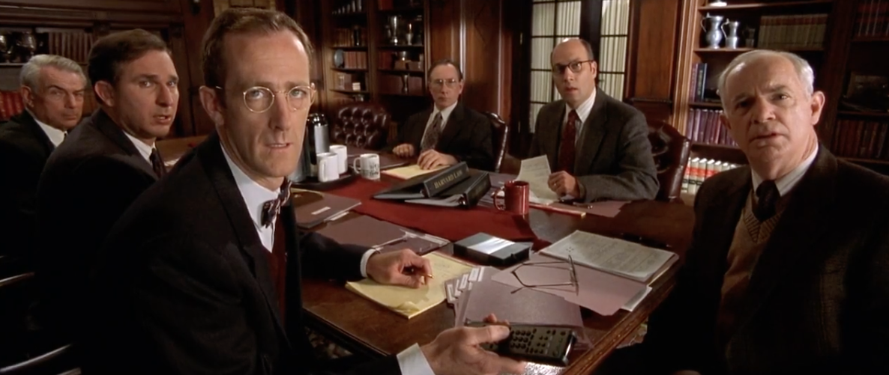
3. Employ creativity
You ought to be original in conveying your response. It could be cliché, but how you bring it out might make it appear unique.
Keep your reader anticipating your next move - Learn from Elle Woods.
You are teaching a new yale course. What's it called?
Swimming with the sharks: A pragmatic approach to high risk, high reward, and exhilarating fun in business.

Slide 9


4. Engage your quirkiness and humor
Read your audience - know how to get them hooked.
Be as funny/weird/serious/introspective as yourself. Respond ‘freely’, but don’t cross the line!
If you aren’t funny, you aren’t funny bruh!
What inspires you?
Memes. Usually hilarious, often controversial, and sometimes caustic. Memes always brighten my day by making me laugh or atleast crack a smile. That small dose of positivity goes a long way in brightening an otherwise bleak day.
What person, past or present, would you invite to speak and what would you ask them to discuss?
German explorer, Johann Ludwig Krapf: you claim that you discovered mt. Kenya yet there were locals living around it before you arrived. So before you discovered it, was it a hill?

Slide 10

HOW TO HANDLE THEM:
NB:
Ultimately, you need to approach the prompt authentically. It’s about YOU!
Also, make sure to HAVE FUN with it - You’re more likely to give an interesting response that’ll keep your reader engaged. (Do not be the boring applicant who makes the AO fall asleep☹)

Slide 11


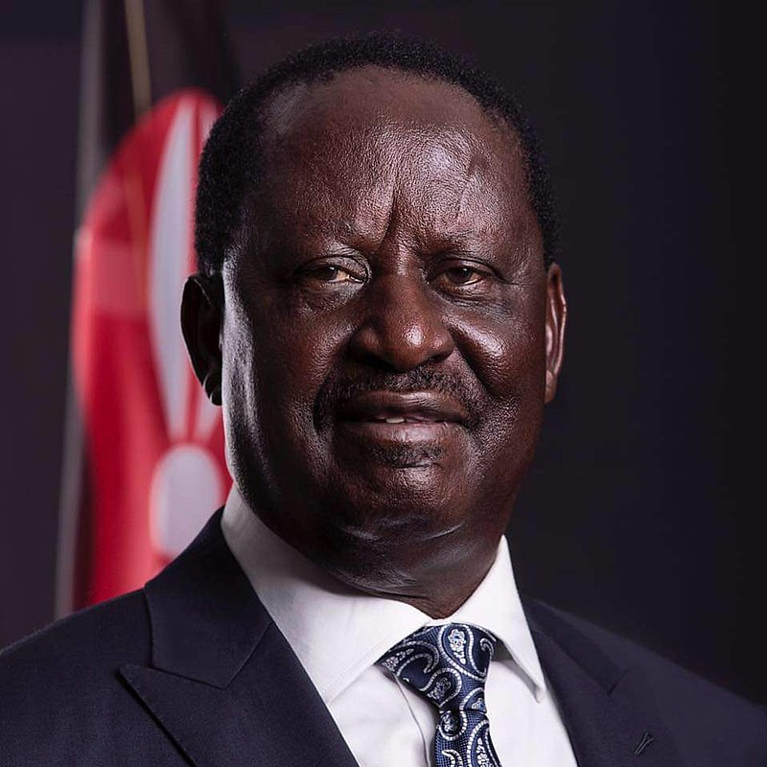

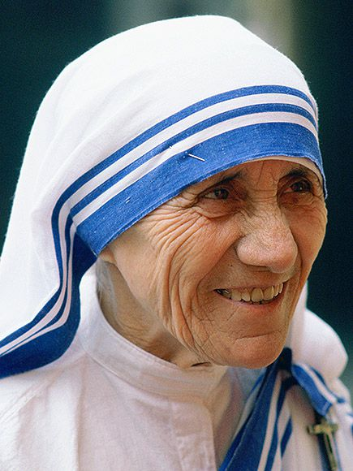
DISCUSSION…
What brings you joy?
Joy is subjective, which makes this question relative.
If it’s open-ended, can you go wrong with any response?

Slide 12

CONCLUSION:
Now that you’ve seen how others did it, get your freak on.
Unleash your inner beast!

Slide 13


ANY QUESTIONS?

Slide 14
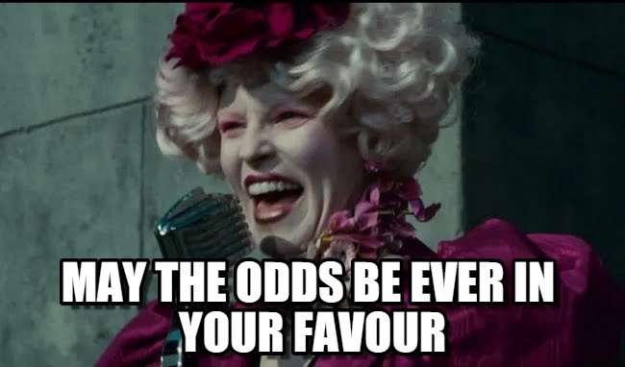
LET THE GAMES BEGIN…

